Slide 1
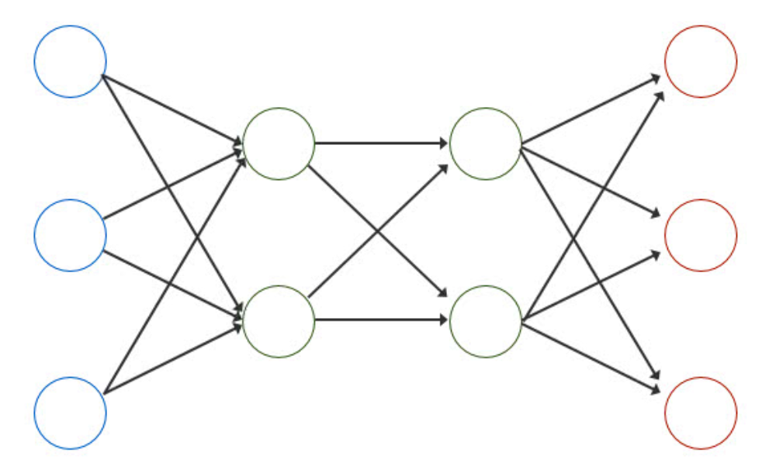

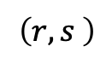
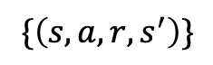
Weekly Report
Model-based offline RL(MOPO)
$$\left(r,s \right)$$
env
$$\{\left(s,a,r,s^{′}\right)\}$$
model
agent
$$\left(s,a\right)$$

Slide 2
Weekly Report
Does MOPO have any weak point?
Can I conclude that MOPO is better than system identification??
S. Levine, A. Kumar, G. Tucker and Justin Fu. “Offline Reinforcement Learning: Tutorial, Review, and Perspectives on Open Problems ”, arXiv preprint arXiv: 2005.01643, 2020.

